Slide 1
The Ultimate Fighting Championship
File created on: 9/12/2020 12:09:17 PM

Slide 2
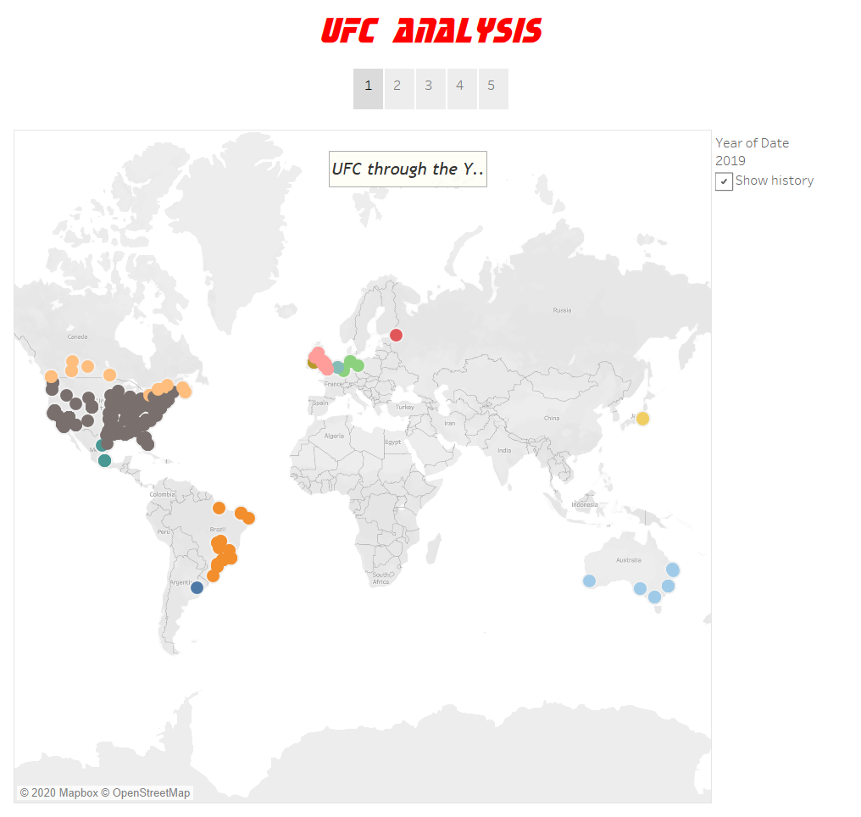

Slide 3
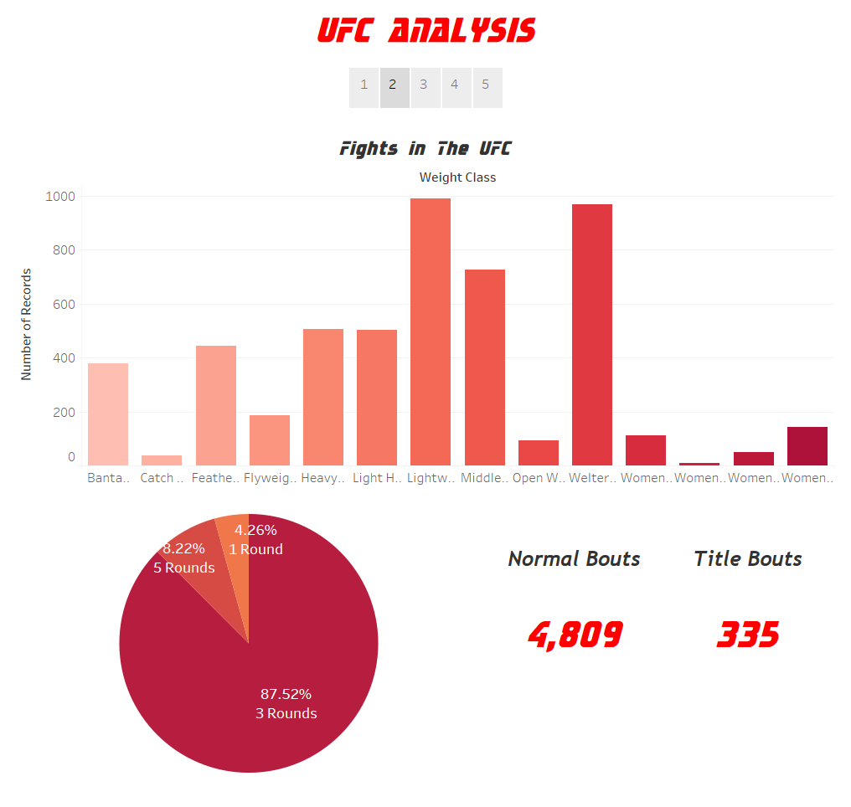

Slide 4
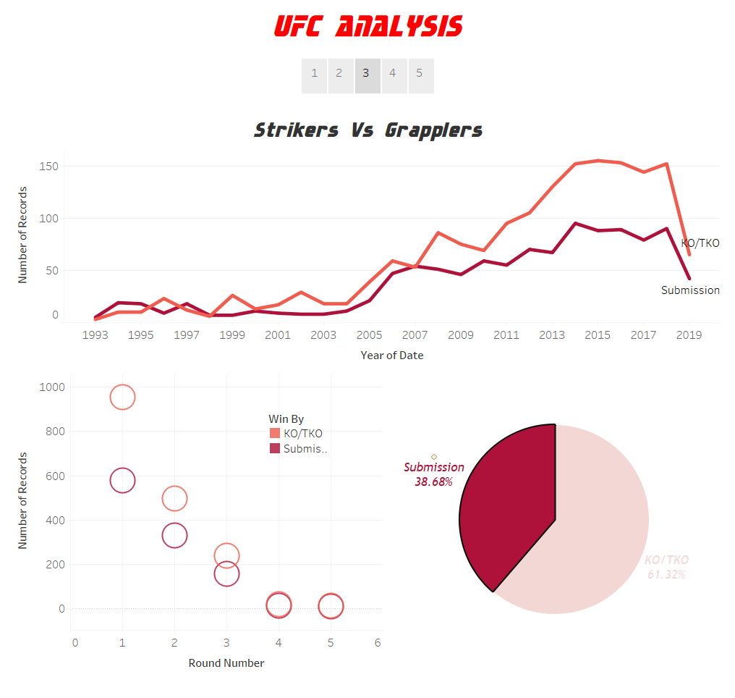

Slide 5
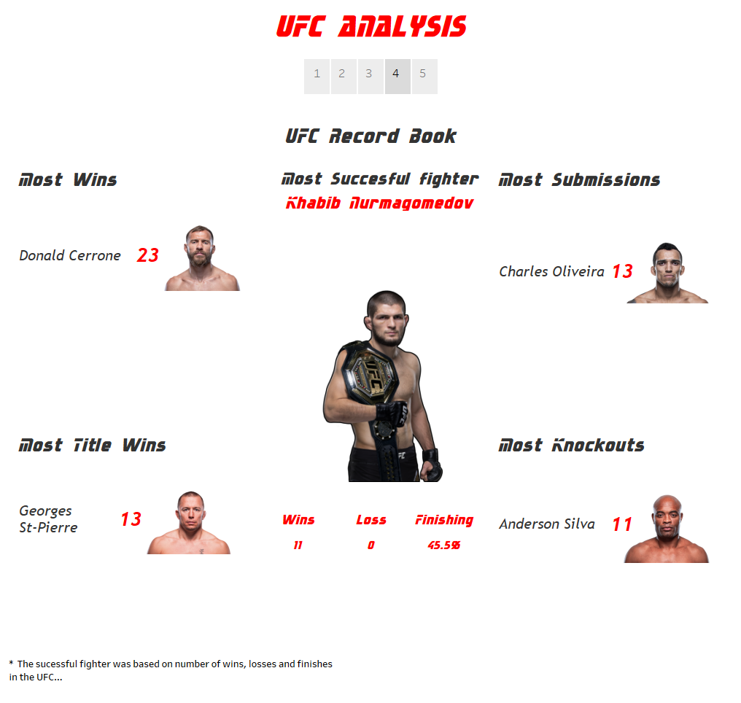

Slide 6
